Slide 1

M5 Forecasting - Accuracy
Estimate the unit sales of Walmart SKUs

Slide 2

Problem Framing
Point Forecast: To predict SKU sales estimates for the next 28 days at a Walmart store in Texas.

Slide 3

Data Overview
Source: Utilized two main datasets: sales data and calendar events data.
Initial Shape: The sales dataset initially contained 30490 rows and 1947 columns before filtering.
Filtering Criteria: Narrowed down to 'HOBBIES' category in 'TX_1' store, Texas, and latest 180 days.
Primary Focus on the impact of cyclical factors (month, week, weekday, and day) on purchase behavior.

Slide 4
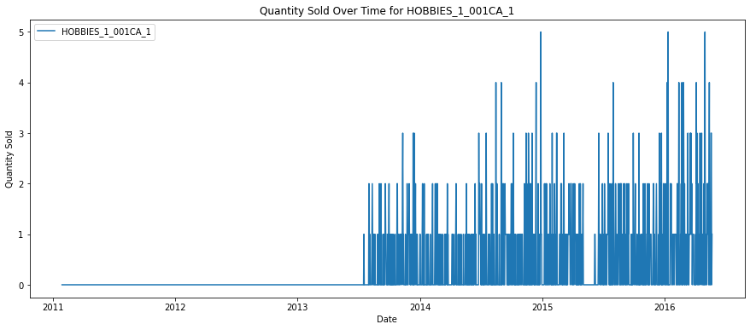
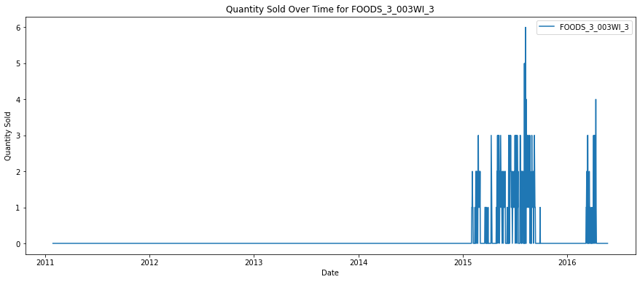
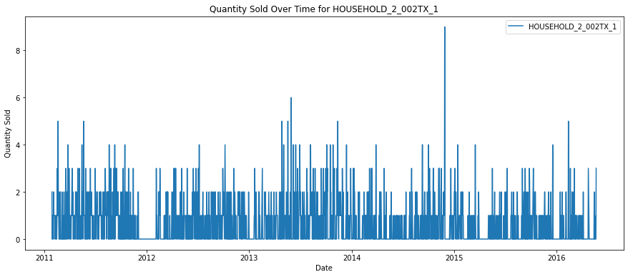
Exploratory Data Analysis
Data Sparsity Challenge:
Examined the extent of zero-sales days across different products.
Experimented with different techniques like data aggregation at weekly and monthly levels.
SKU Data Visualization:
Selected three random SKUs to illustrate the sparsity issue over the entire timeline.
Focused Analysis Scope:
Concentrated on the 'HOBBIES' category within the 'TX_1' store in Texas.
Narrowed down the dataset to a specific segment for a more detailed examination.

Slide 5
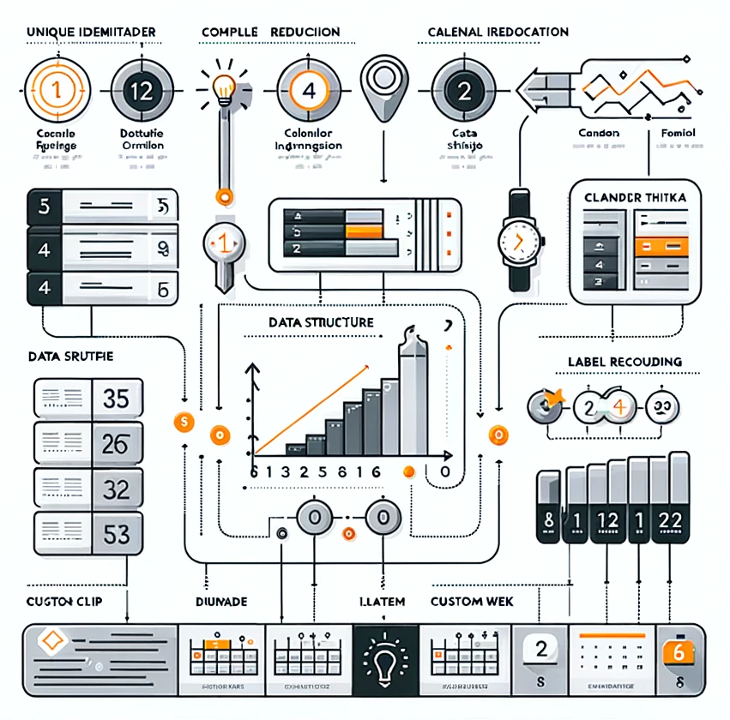
Data Preprocessing and Feature Engineering
Unique Identifier: Created a 'unique_id' by concatenating 'item_id' and 'store_id' to uniquely identify each product in the store.
Column Reduction: Removed unnecessary columns to focus solely on the daily sales data and the new 'unique_id'.
Data Structure: Transposed the dataset to a time series format, aligning sales data with corresponding dates.
Calendar Integration: Enhanced the sales dataset with calendar attributes such as date, day, month, and special events.
Label Encoding: Encoded categorical variables like 'event_name' and 'event_type' into numerical form for model ingestion.
Custom Week Feature: Created a 'week_of_yr' feature to capture sales patterns on a weekly basis, improving model granularity.
Applied Sine and Cosine function on periodic variables such as day, week_day, week_of_the_year, and month values

Slide 6
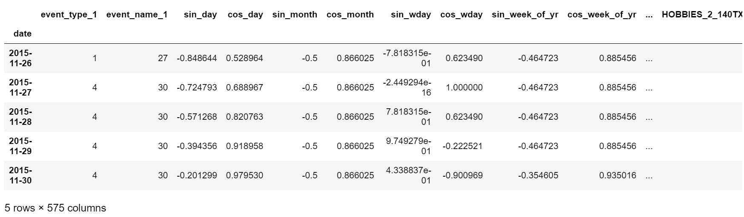
Data View

Slide 7
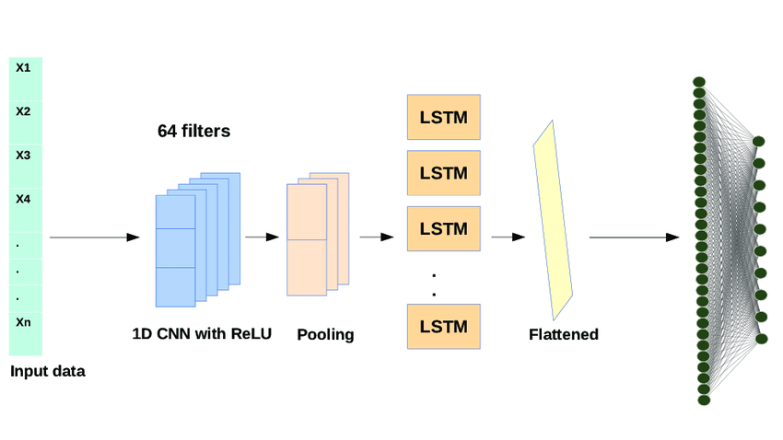
Model Selection and Forecasting Approach
Model Used: Chose Long Short-Term Memory (LSTM) networks for forecasting quantities due to their effectiveness in capturing long-term dependencies in time series data, crucial for understanding sales patterns in retail.
Rationale: LSTMs are well-suited for the complex, sequential nature of sales data, capable of learning from the seasonality, trends, and impact of events over extended periods.

Slide 8

Model Training and Validation
LSTM Architecture: Configured the LSTM with 2 layers and 128 and 64 neurons per layer, designed to effectively capture the temporal dependencies in the sales data.
Activation and Loss Functions: Utilized ‘Relu’ as the activation function in the LSTM layers, with Mean Squared Error as the loss function to guide the training process.
Optimizer: ADAM optimizer with a learning rate of 0.0001 to fine-tune the network weights during training.
Input Features: The model was fed with a set of features including events and cyclical time parameters to predict future sales.
Sequence Length: Experimented with different sequence lengths (10, 12, 15, 30, 35) based on the sizes of input data.

Slide 9
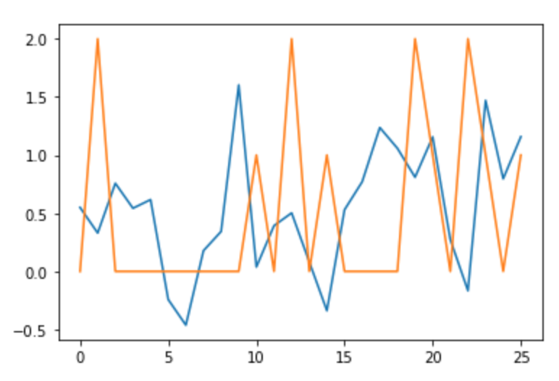
Validation Strategy and Performance Evaluation
Validation Approach: Adopted a train-val-test split approach as suggested on Kaggle to assess the model's forecasting ability on unseen data, ensuring a robust evaluation of its performance.
Performance Metrics: The model's accuracy was quantified using RMSSE, providing a normalized measure of the forecast error relative to a naive benchmark, making it a stringent metric for time series forecasting.
Results: The best RMSSE score was 1.1 and the worst was 1.6. Based on these results, the model can be further fine-tuned and additional features can be given as input to improve the RMSSE score.

Slide 10

Model Insights and Interpretation
Learning Dynamics: Discussed how the LSTM model adapted to the sales data characteristics, capturing underlying patterns such as seasonality, trend, and the impact of promotional events.
Future Scope:
Include more features
Fine tune the model further
Try other models such as GRU and VAR to conduct multi-variate analysis including price fluctuations.

